Slide 1

EXAMINING THE TRADING WITH CHANDE MOMENTUM OSCILLATOR
PRESENTED BY
RITTIK DHAR

Slide 2
INTRODUCTION
THE CHANDE MOMENTUM OSCILLATOR IS A TECHNICAL MOMENTUM INDICATOR INVENTED BY TUSHAR CHANDE.
THE FORMULA CALCULATES THE DIFFERENCE BETWEEN THE SUM OF RECENT GAINS AND THE SUM OF RECENT LOSSES AND THEN DIVIDES THE RESULT BY THE SUM OF ALL PRICE MOVEMENT OVER THE SAME PERIOD.

Slide 3
OBJECTIVE OF THE STUDY
TO EXAMINE THE TRADING WITH CHANDE MOMENTUM OSCILLATOR TO EARN MONEY .

Slide 4
METHODOLOGY
THE DATA ARE COLLECTED FROM SECONDARY SOURCES FROM THE FOLLOWING WEBSITES.
https://www.moneycontrol.com/india/stockpricequote/infrastructure-general/bharatheavyelectricals/BHE
https://s3.tradingview.com/

Slide 5
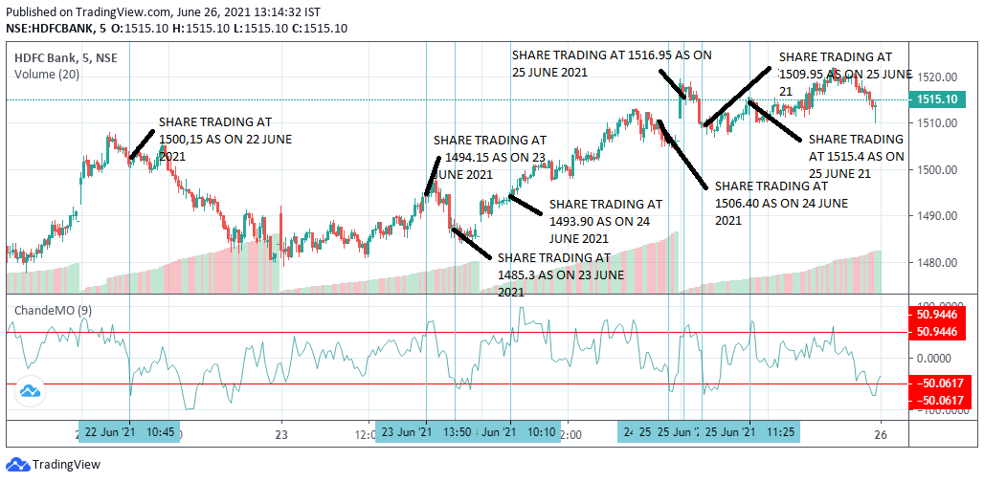
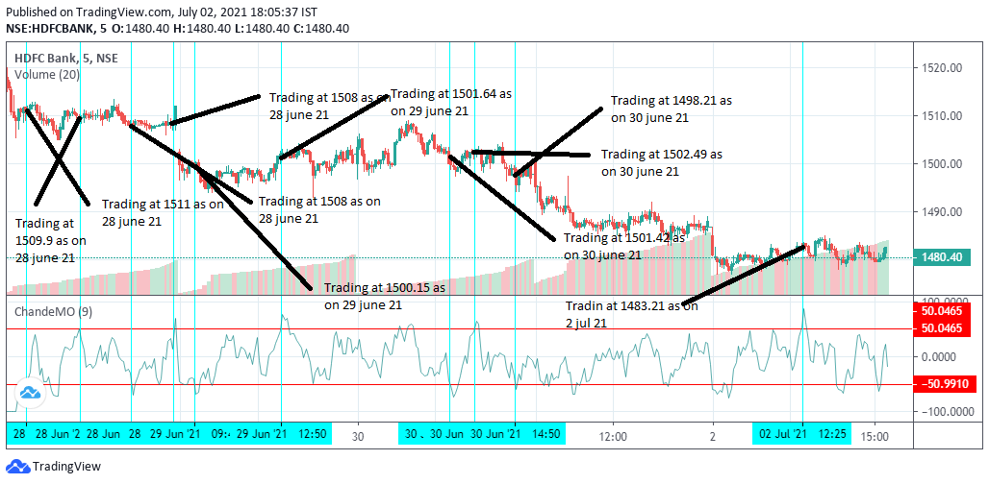
EXAMINING TRADING WITH CMO HDFC BANK(TWO WEEKS)
FIRST WEEK TRADING
SECOND WEEK TRADING
STOCKS | PROFIT/LOSS(IN RS) | COMMENT
HDFC BANK | (342.5) | LOSS

Slide 6
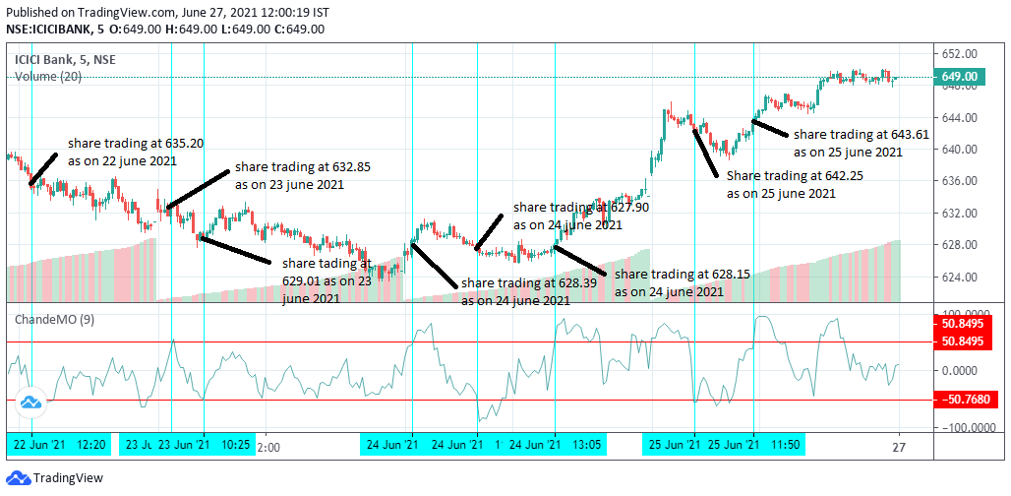
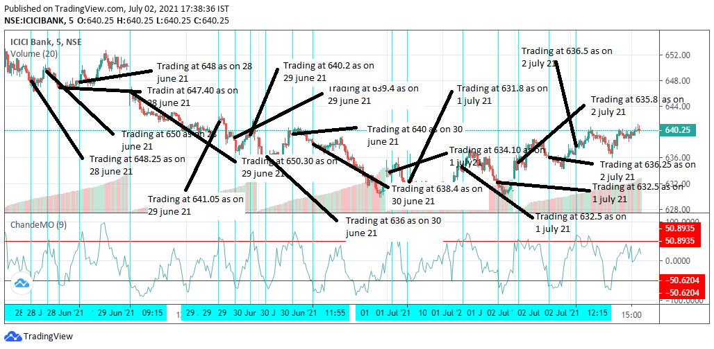
ICICI BANK
FIRST WEEK TRADING
SECOND WEEK TRADING
STOCKS | PROFIT/LOSS(IN RS) | COMMENT
ICICI BANK | (361.5) | LOSS

Slide 7
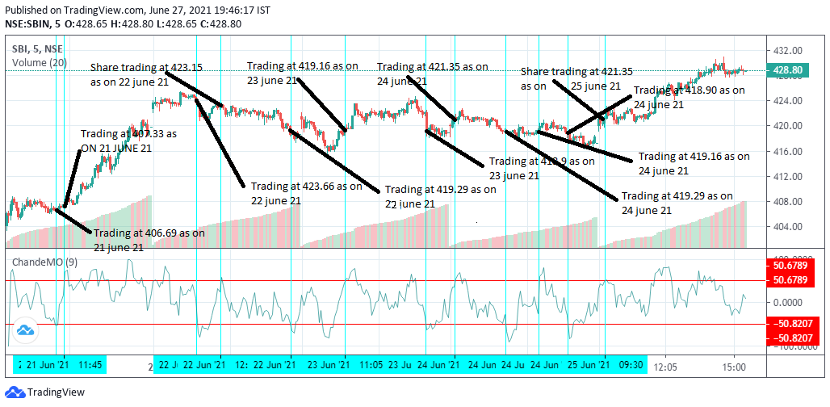
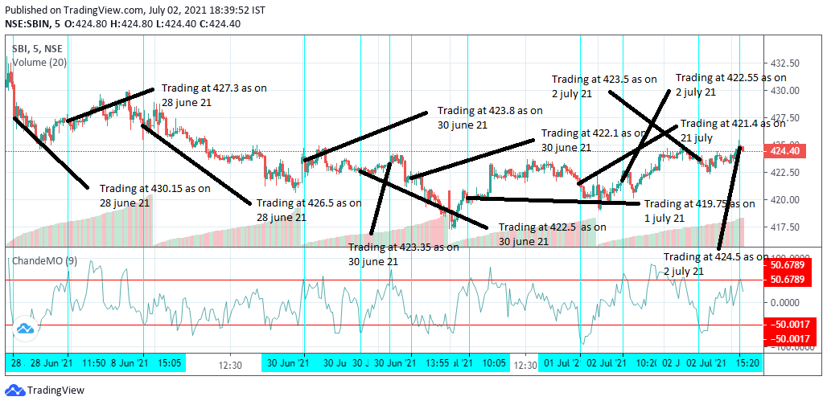
SBI BANK
FIRST WEEK TRADING
SECOND WEEK TRADING
STOCKS | PROFIT/LOSS(IN RS) | COMMENT
SBI BANK | 159 | PROFIT

Slide 8
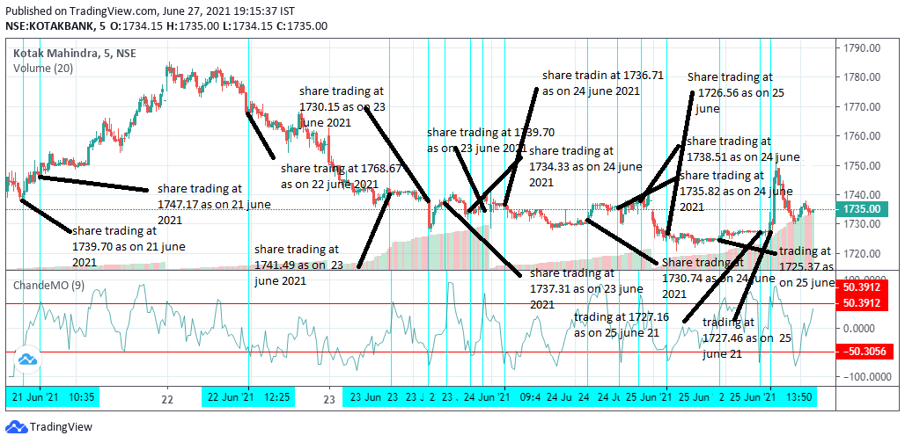
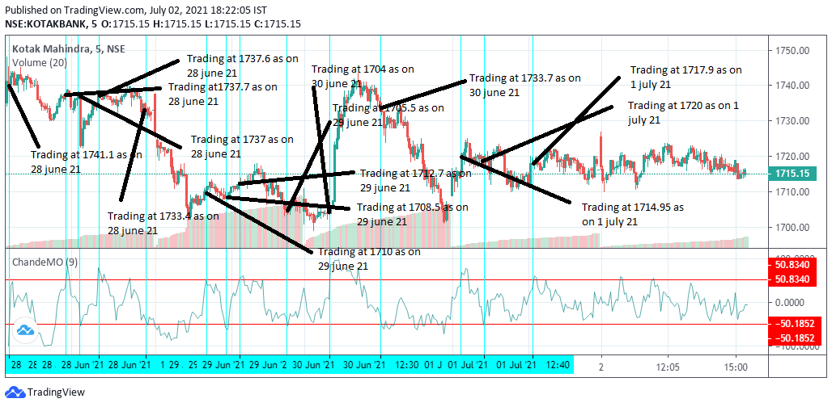
KOTAK MAHINDRA BANK
FIRST WEEK TRADING
SECOND WEEK TRADING
STOCKS | PROFIT/LOSS(IN RS) | COMMENT
KOTAK MAHINDRA BANK | (3469) | LOSS

Slide 9
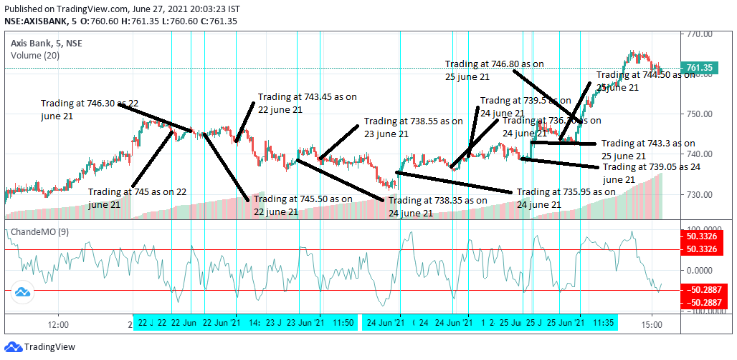
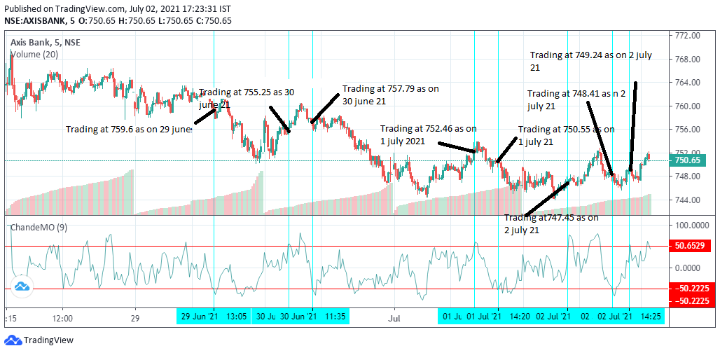
AXIS BANK
FIRST WEEK TRADING
SECOND WEEK TRADING
STOCKS | PROFIT/LOSS(IN RS) | COMMENT
AXIS BANK | (437.5) | LOSS

Slide 10
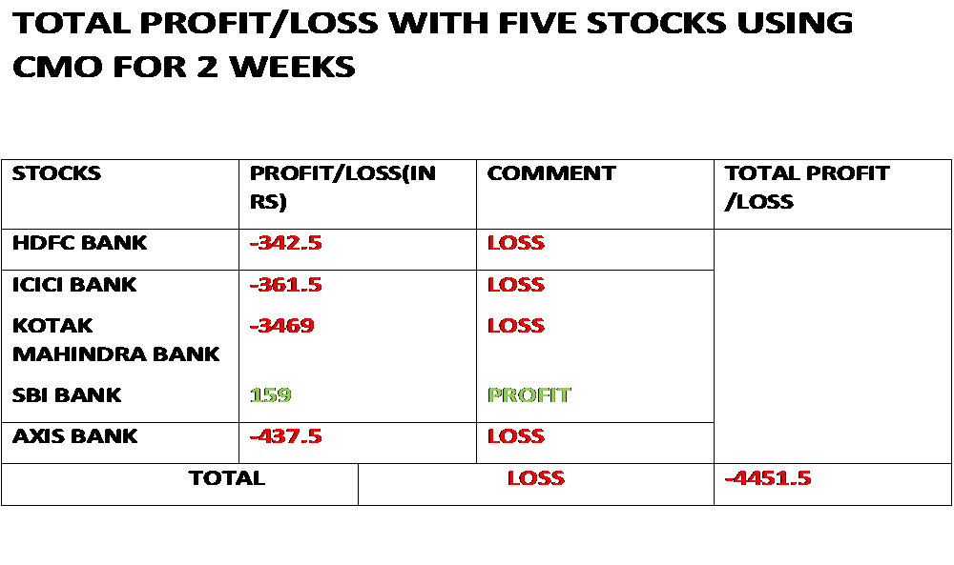

Slide 11
CONCLUSION
BY EXAMINING TRADING USING FIVE STOCKS FOR TWO WEEKS WITH CMO I FOUND OUT THAT I GOT LOSS AND I AM UNABLE TO EARN MONEY SO I WOULD NOT RECOMMEND CMO FOR TRADING.

